Slide 1
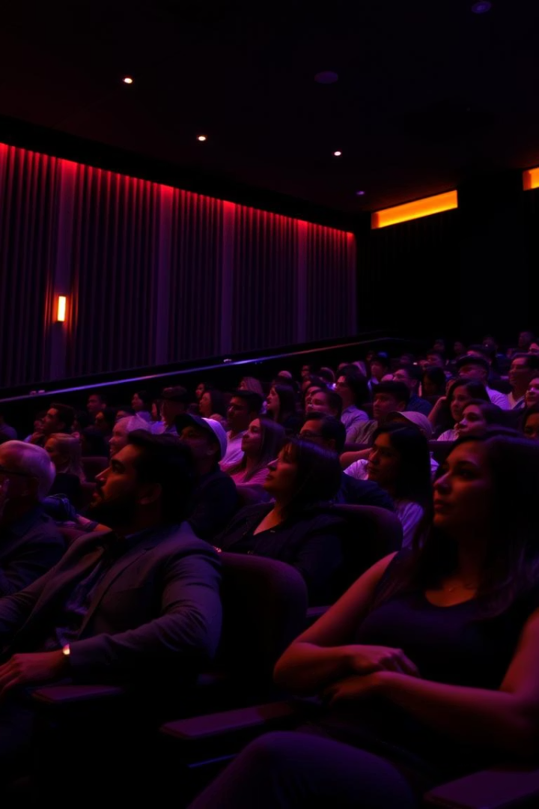
MOVIELENS RECOMMENDATION SYSTEM
Building a personalized movie recommendation system using collaborative and content-based filtering.

Slide 2

Business Understanding & Problem Statement
Enhanced User Experience
Unlock Long Tail Value
Personalized recommender systems guide users through vast digital catalogs, boosting satisfaction and discovery.
Intelligent filtering and prediction helps surface niche content that users may have overlooked.
Improved Business Outcomes
Personalized experiences drive user engagement, loyalty, and revenue growth for digital businesses.
Problem Statement
Recommend Relevant Movies
Discover New Content
Provide personalized movie recommendations from vast catalogs to improve user satisfaction.
Help users find new movies they'll love based on their individual preferences and viewing history.
Increase Engagement
Enable businesses to retain users and improve content engagement through tailored recommendations.

Slide 3
Project Overview
Objectives
Key Features
Predict the top 5 movies personalized for each user based on their past ratings and behaviors.
Dataset: MovieLens small with 100,004 ratings
Core method: Collaborative filtering
Leverage collaborative filtering and hybrid approaches to handle cold start scenarios.
Evaluation: Precision@K > 0.6
Stretch goal: Hybrid model for cold start
File
Records
Features
Movies
58,098
Title, Genres, Year
Ratings
100,004
UserID, MovieID, Rating (0.5-5.0)
Tags
3,684
User-generated metadata

Slide 4

Data Understanding & Cleaning
Data Merging
Cleaning
Feature Engineering
Combined movies, ratings, and tags into one dataset with 233,213 entries.
Checked for nulls and duplicates, removed outliers using IQR method.
Extracted release year from titles, split and one-hot encoded genres.
Normalization
Normalized ratings and timestamps for better model performance.

Slide 5
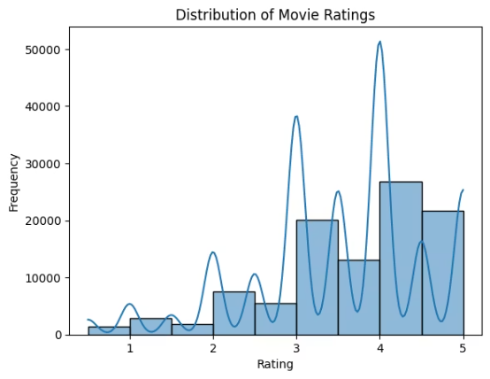
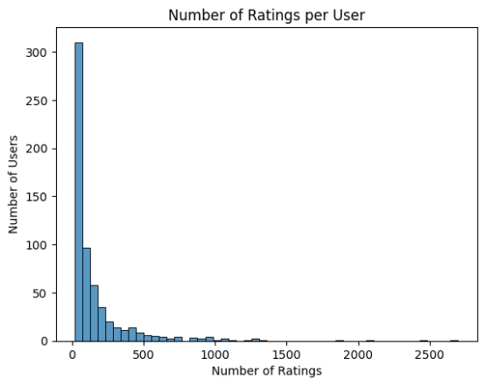
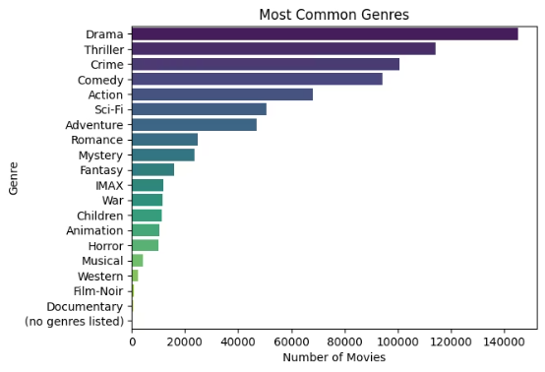
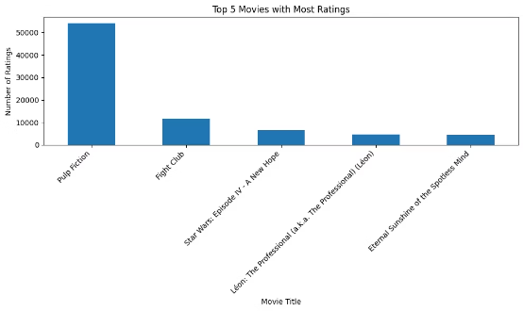
Exploratory Data Analysis
Rating Distribution
Top Movies & Users
Genres & Trends
Ratings mostly between 3-5, with 4.0 and 5.0 most common.
Few users rated majority of movies; Pulp Fiction highest rated.
Common genres: Drama, Comedy, Action. Frequent tags: Pixar, war, classic.

Slide 6
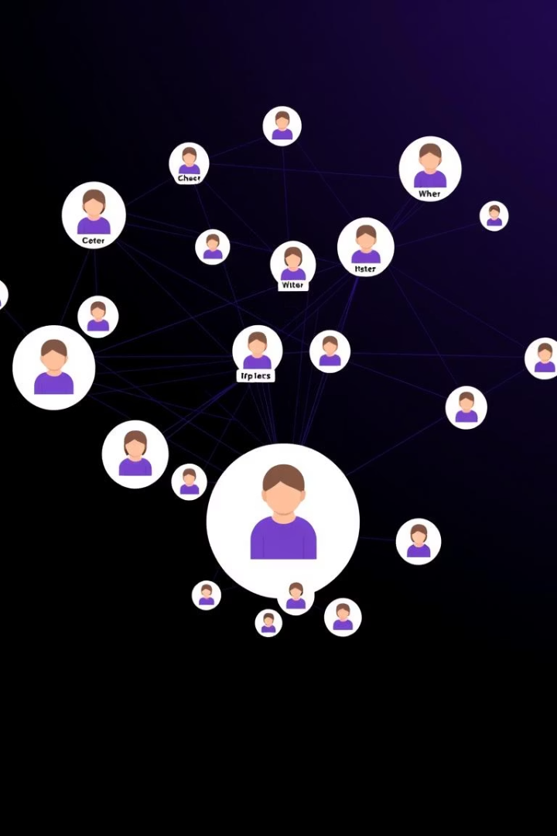
Modeling: Collaborative Filtering
User-Based CF
Item-Based CF
Low precision due to cold start and sparse ratings amounting to 98.3% in utility matrix
Improved precision (0.6) by focusing on item similarities.
Matrix Factorization (SVD)
Poor performance likely due to data reduction and mean imputation.

Slide 7
Content-Based & Hybrid Filtering
Content-Based Filtering
Hybrid Model
Uses tags and metadata but suffers from sparse TF-IDF matrix.
Combines content and item-based filtering, achieving precision of 0.6.
Best balance for cold start and recommendation accuracy
Precision@K
Recall@K
User Based Collaborative Filtering
0.0
0.000
Item Based Collaborative Filtering
0.6
0.005
Matrix Vectorization SVD
0.0
0.000
Content Based Filtering
0.0
0.000
Hybrid: Content Based and Collaborative Filtering
0.6
0.005

Slide 8

Classification Models for Movie Preferences
Random Forest
Decision Tree
Best performance with 87% precision and 83% recall.
Good precision (84%) and recall (85%), slightly below Random Forest.
Gradient Boosting & Neural Net
Poor recall and precision; need further tuning and balancing.
precision
recall
Random Forest Classifier
0.875
0.8220
Gradient Boosting Classifier
0.747
0.0400
Neural Network Classifier
0.000
0.0000
Decision Tree Classifier
0.838
0.8408

Slide 9

Summary & Future Recommendations
Achievements
Collaborative Filtering: Used user/item-based models. Reduced cold start issues.
Hybrid Model: Combined collaborative & content-based filtering. Achieved Precision@5 = 0.6.
Classification Models: Helped distinguish liked vs. disliked movies. Random Forest was most effective.
Top-5 for User 68 (Pulp Fiction): Forrest Gump, Ferris Bueller's Day Off, Se7en, Silence of the Lambs, The Usual Suspects
Success Criteria
High Precision: 3/5 accurate recommendations
User Alignment: Recommendations match preferences
Scalability: Ready to incorporate new users/movies
Challenges
Data sparsity & limited ratings
Long training time; runtime crashes
Future: Tune models, balance classes, add real-time UI
Next Steps
Hyperparameter Tuning Fine-tuning model settings (like number of neighbors, depth, learning rate) could greatly improve accuracy and performance.
Model Optimization Improving model efficiency through feature selection, dimensionality reduction, and regularization helps prevent overfitting.
Computational Constraints Training large models requires significant memory and processing time—leading to crashes and delays without optimized hardware or cloud support.

Slide 10

Thank You!
Thanks for exploring our Movielens recommendation system project.
Prepared by:
Maureen Ngahu
Immaculate Kimani
James Mwaura
Maureen Maina
Jael Kirwa
Japhet Cheboiywo

